Slide 1

INX Future INC - Employee Performance Analysis
Presented by Aravind Kalla
May 16, 2025

Slide 2

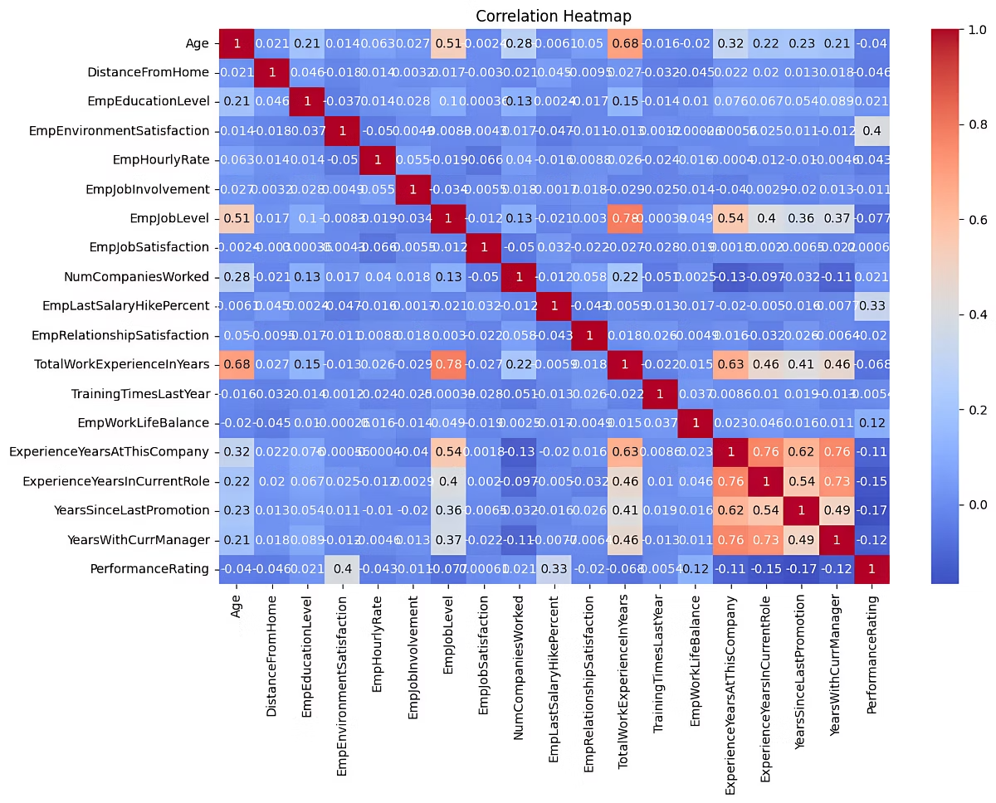
Top Insights from Feature Importance
The Random Forest model highlights key performance drivers.
Top features: Job satisfaction, environment quality, and work-life balance.
Medium impact from promotion timing and company experience.
Raises alone don’t strongly predict performance gains.

Slide 3
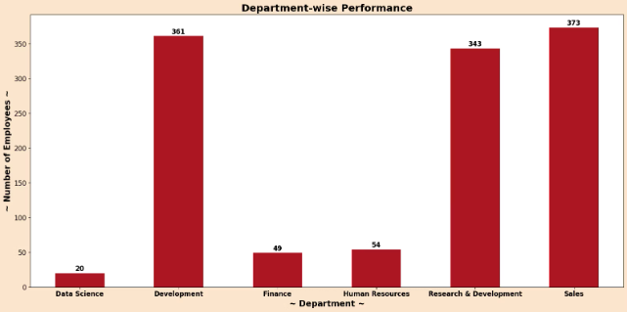
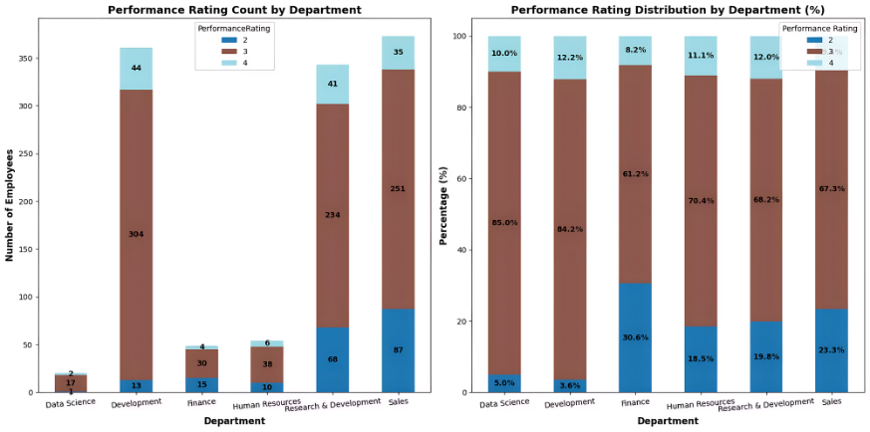
Department-Level Insights
Certain departments demonstrate significantly lower employee ratings.
Variability in leadership quality
Uneven distribution of workloads
Lack of clear role definitions or inadequate training

Slide 4

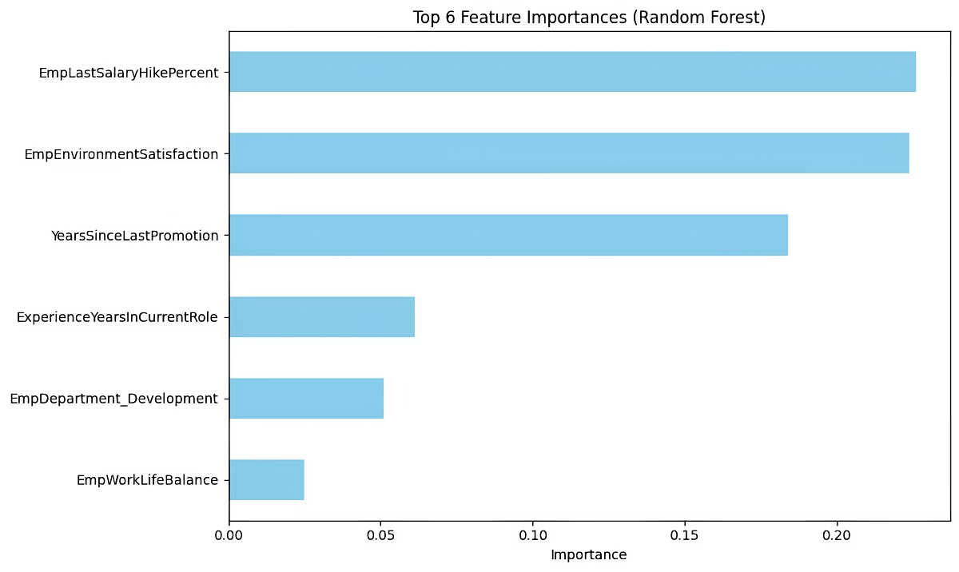
Actionable Recommendations
1
Enhance Job Satisfaction
Use surveys, voice channels, clear paths, and recognition programs.
2
Improve Work Environment
Invest in workspace, culture, and provide tools for success.
3
Support Work-Life Balance
Promote flexible hours, manage workload, and offer wellness programs.
4
Promotions and Growth
Address stagnation with development plans, skills matching, mentorship.

Slide 5

HR Practical Usage
Use prediction scores scaled 0 to 1 to prioritize candidates.
Set a minimum threshold, e.g., 0.6, to identify high potential.
Flag at-risk employees early for targeted support and retention efforts.

Slide 6

Thank You

